Slide 1
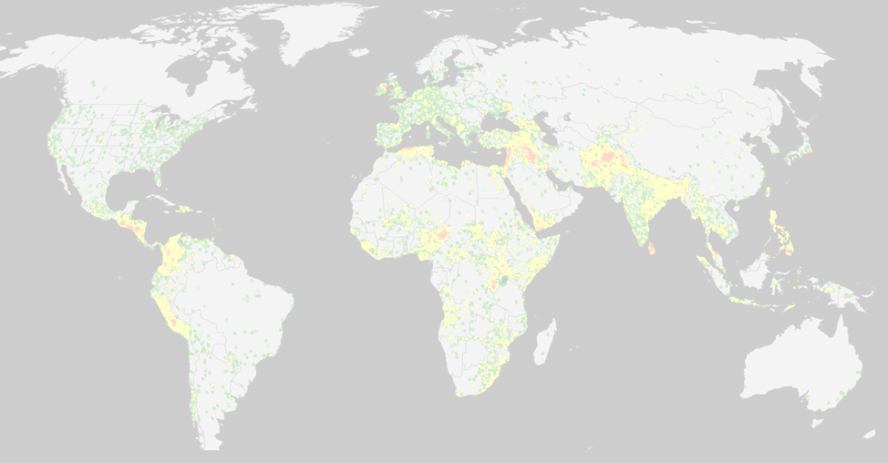

Max Herrera, Joshua Herrera, Patrick McDevitt, and Sunna Quazi
MSDS 7330 File Organization and Database Management
Section 405, Group A

Slide 2

Global Terrorism Database
Open-source database including information on terrorist events around the world
Terrorist Attacks from 1970-2015
156,772 terrorist attacks
More than 83,000 bombings, 18,000 assassinations, and 11,000 kidnappings since 1970
137 Attributes
Systematic data on domestic as well as international terrorist incidents
Over 4,000,000 news articles and 25,000 news sources were reviewed to collect incident data from 1998 to 2016 alone
https://www.kaggle.com/START-UMD/gtd. (29 Mb)
https://www.start.umd.edu/gtd
Currently the most comprehensive unclassified database on terrorist events in the world

Slide 3

Team Project
Identified GTD as opportunity to explore / organize / normalize / evaluate a large dataset in support of objectives of this course
Identified relational database as most supportive for this database and project
Convert raw data set to usable tables
Imported to SQL database
Normalized database
Identified time-based and geographic insights

Slide 4

GTD defines Terrorism as:
"The threatened or actual use of illegal force and violence by a non-state actor to attain a political, economic, religious, or social goal through fear, coercion, or intimidation."

Slide 5

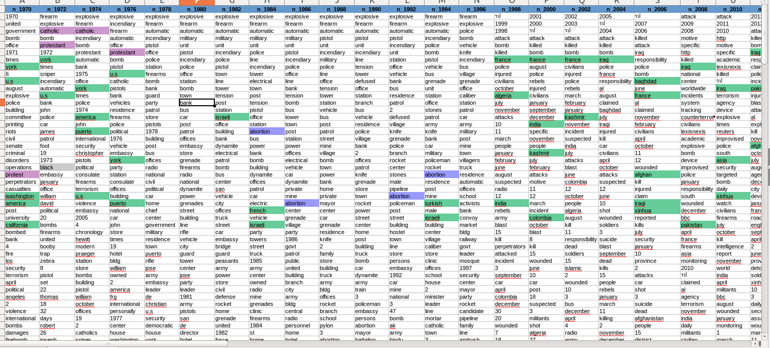
Feel the Data
Before loading the data, it’s a good idea to get a summary of what we are looking at
Below is a text analysis performed in excel on the top 200 words in the dataset
Observable Trends
1970s: Catholics vs. Protestants, US, Puerto Rico
1980s: Abortion, Israel
1990s: Turkey, Israel, India

Slide 6


Why Choose SQL?
We didn’t know about MongoDB until last week ;)
Raw dataset was in tabular / column structure
The 137 attributes are interdependent, which complement an relationship database
There was seemingly a great amount of redundant data, which would benefit from normalization
Relational database facilitates analyzing the multiple subtypes of information: geographic, forensic, demographic, political

Slide 7

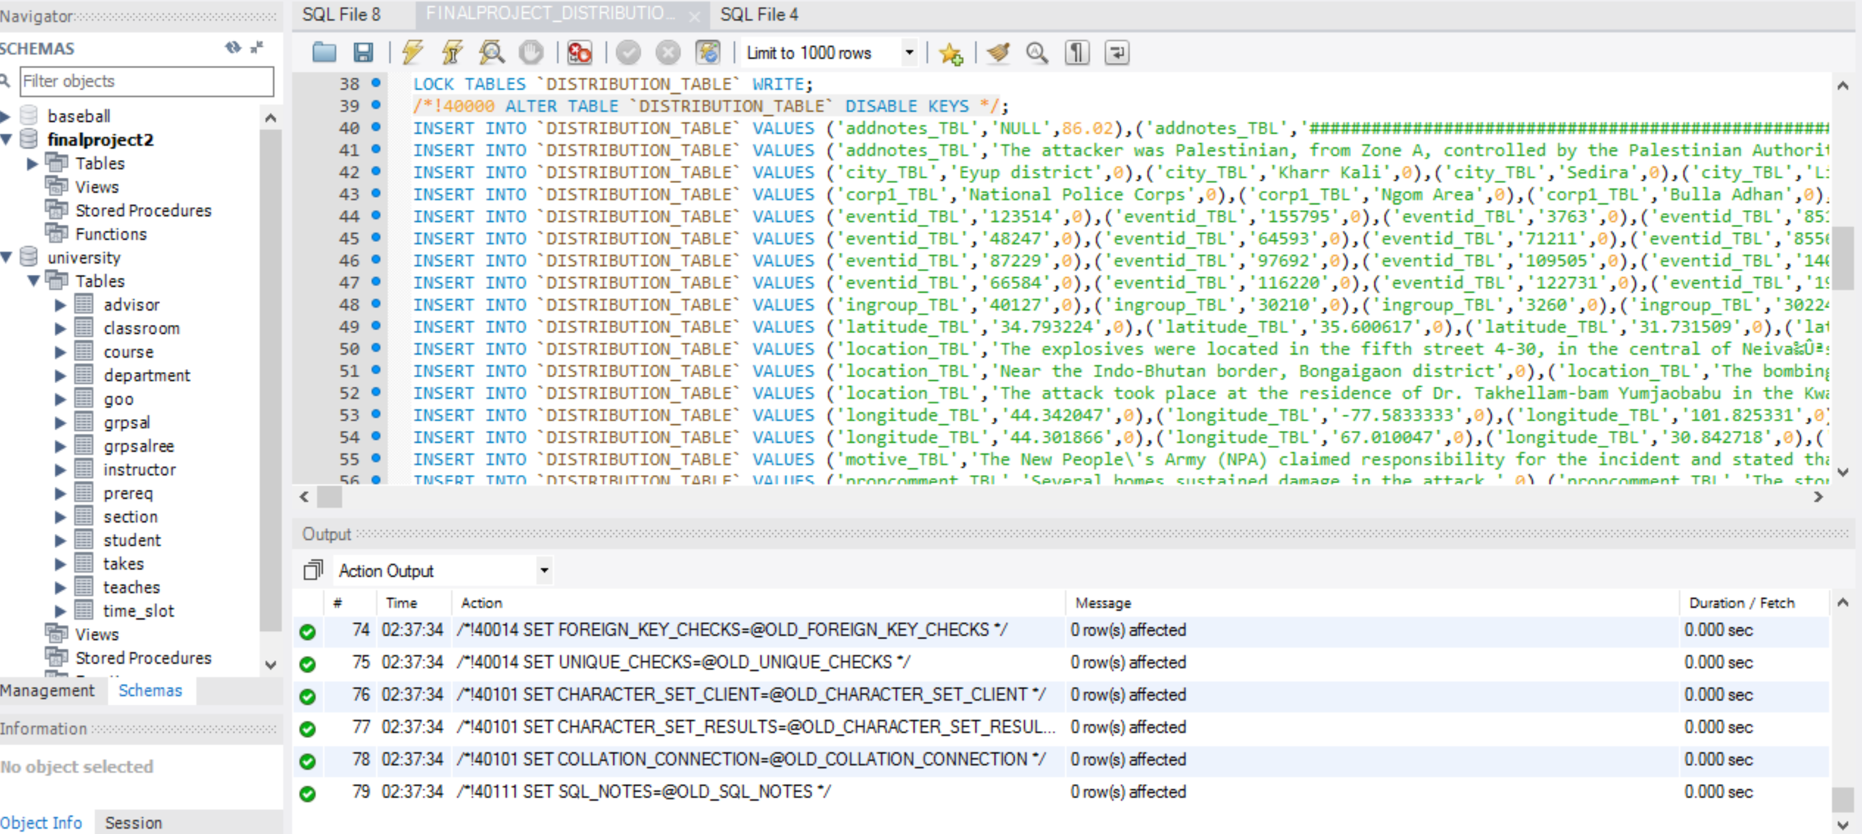

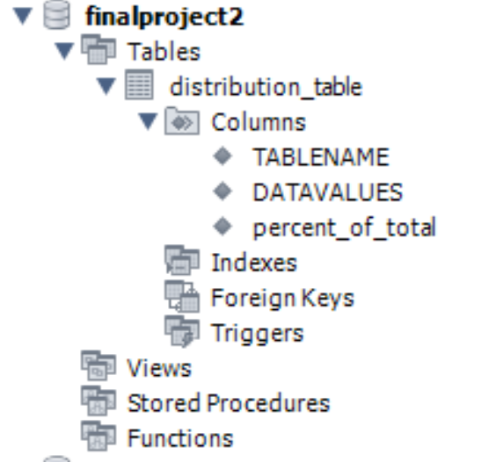
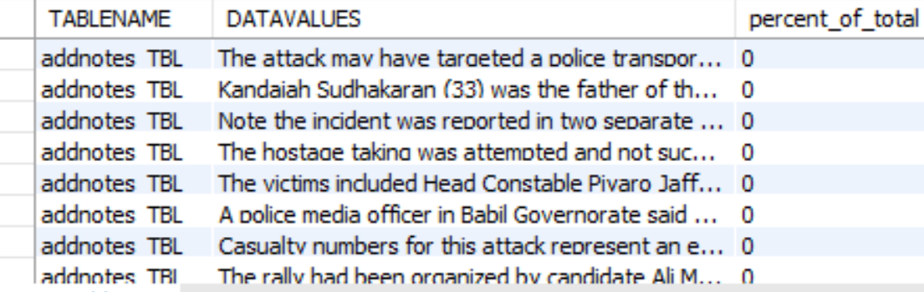
Data Loading Pitfalls
Initially, the GT data would not import into MYSQL
We needed to make each column varchar(MAX) initially. Each column was surrounded by triple quotes, so we cleaned up the data.
File size of DDL file 48.8mb
Data Definition File (DDL)
Loaded Schema
Table Excerpt

Slide 8

Data Wrangling
Import the data into a Microsoft SQL Server database.
We needed to make each column varchar(MAX) initially. Each column was surrounded by triple quotes, so we cleaned up the data:
Write scripts to determine the max length of each column, and alter the column width for each of the 127 columns accordingly.
Use the sliding window functions to determine distribution of values for each of the 127 columns.
Output the distribution of values per column into one table, DISTRIBUTION_TABLE.
Connect the SQL server to MYSQL to transfer the data using SSIS via an ODBC connection.
Perform a MYSQL dump of the data for the GT (I.e., the global terrorism table) and the DISTRIBUTION_TABLE and uploaded it into box so that it could be loaded by the other teammates.
This allowed the team to start with the same dataset.
All the scripts that were created to wrangle, and analyze the data can be found here. https://smu.box.com/s/zhbm2idikopnuhxfvcxtmc880nud5pxa. There were 22 scripts written to wrangle and profile the data. The SQL dump generated to scripts, which can be found in the importdataintomysql folder. The stored procedures and sql used is for both microsoft sql server and mysql

Slide 9

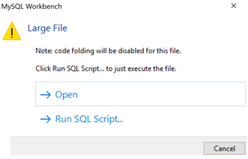
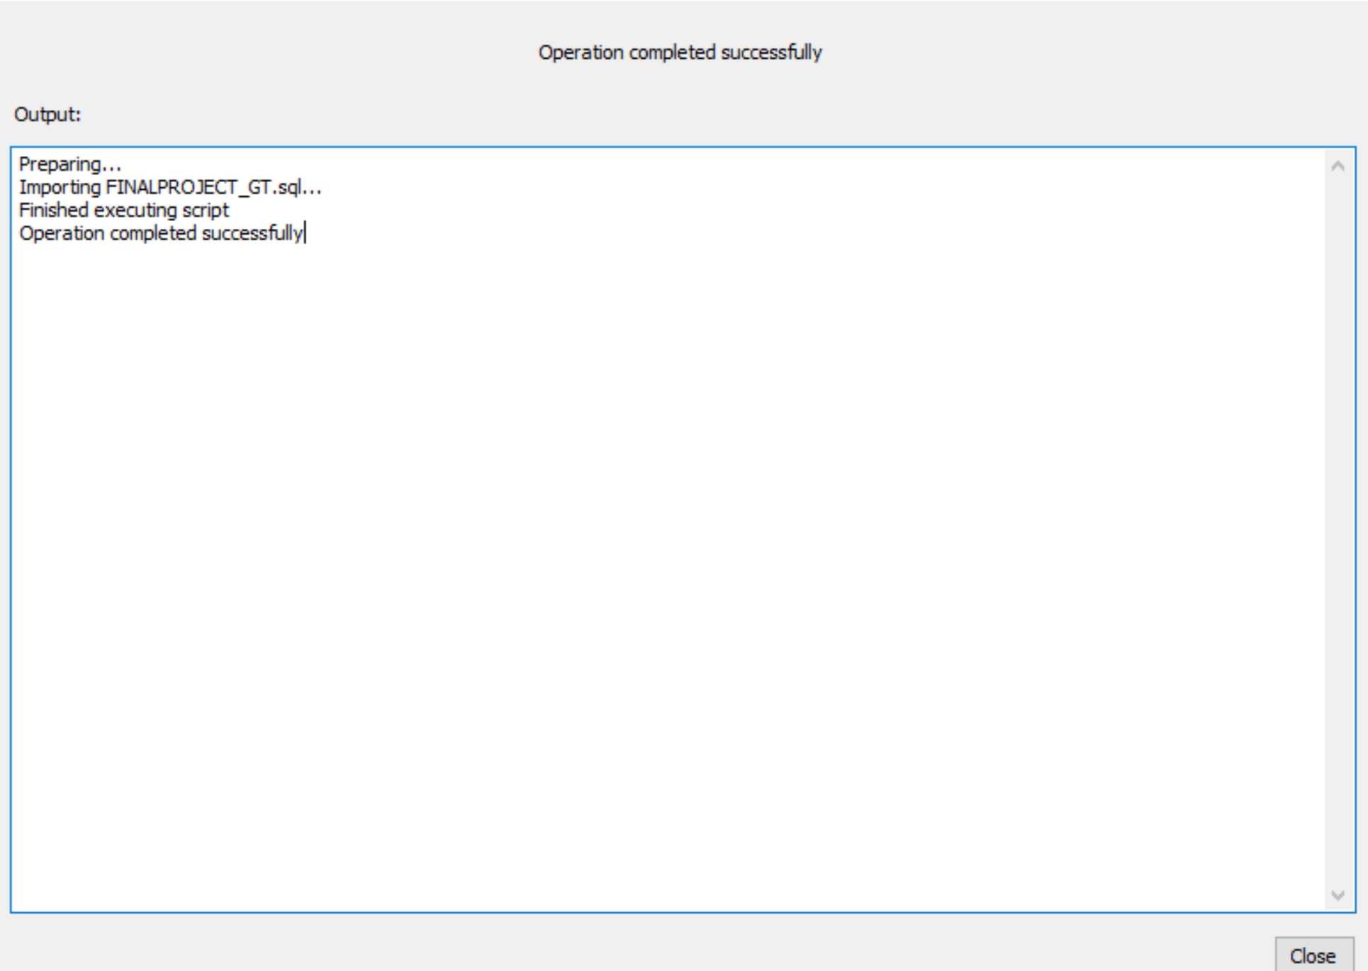
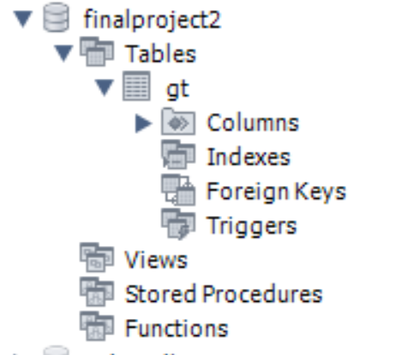
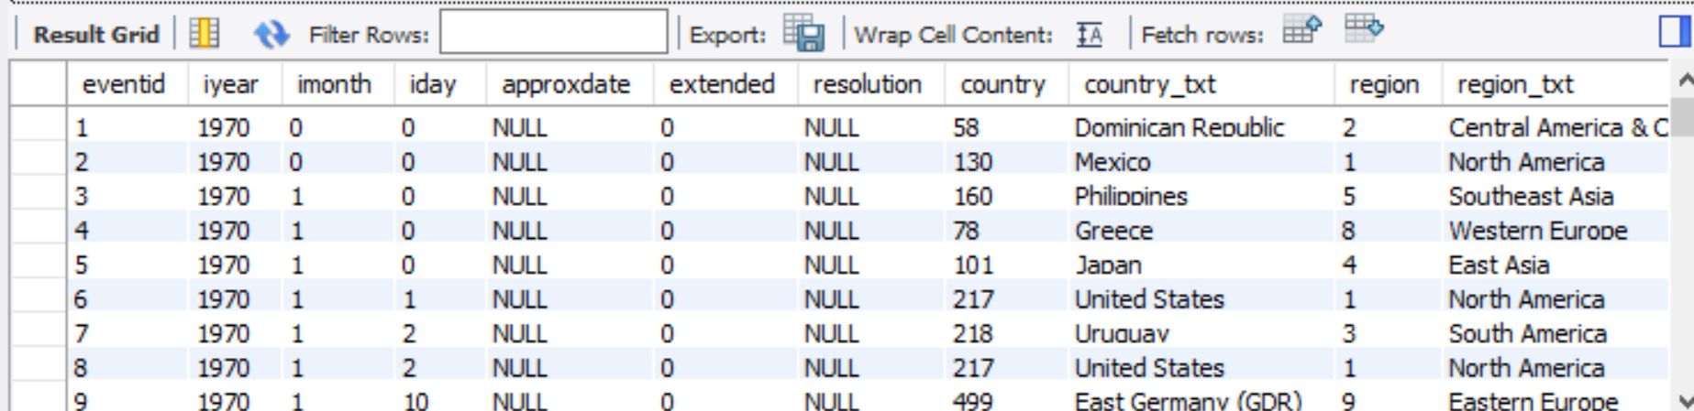

Our Framework
Final File size is 201mb (from 29mb)
Loading Data- Too Large
Importing
Loaded Schema
Table Excerpt
Summary

Slide 10

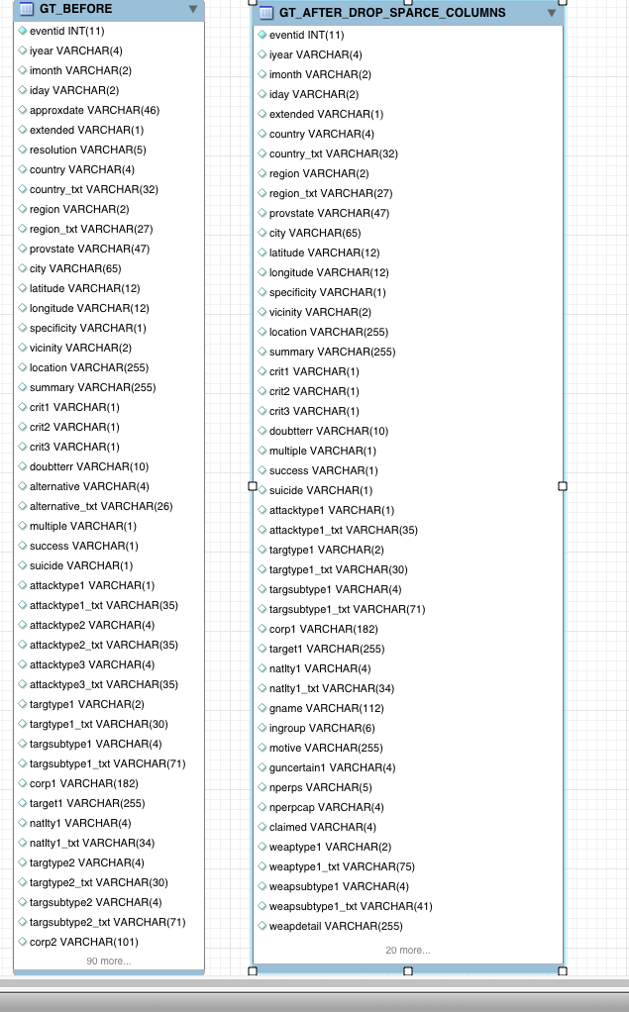
Data Profiling
Having moved the data to MYSQL, we ran scripts that determined which columns were sparse
The criterion for sparseness was that 80% or more of the column was NULL or contained ‘.’
“When you look into an abyss, the abyss also looks into you “
-Frederick Nietzsche
We created alter tables for the sparse columns and dropped them
At this point, the table was ready for normalization

Slide 11
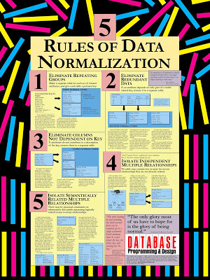
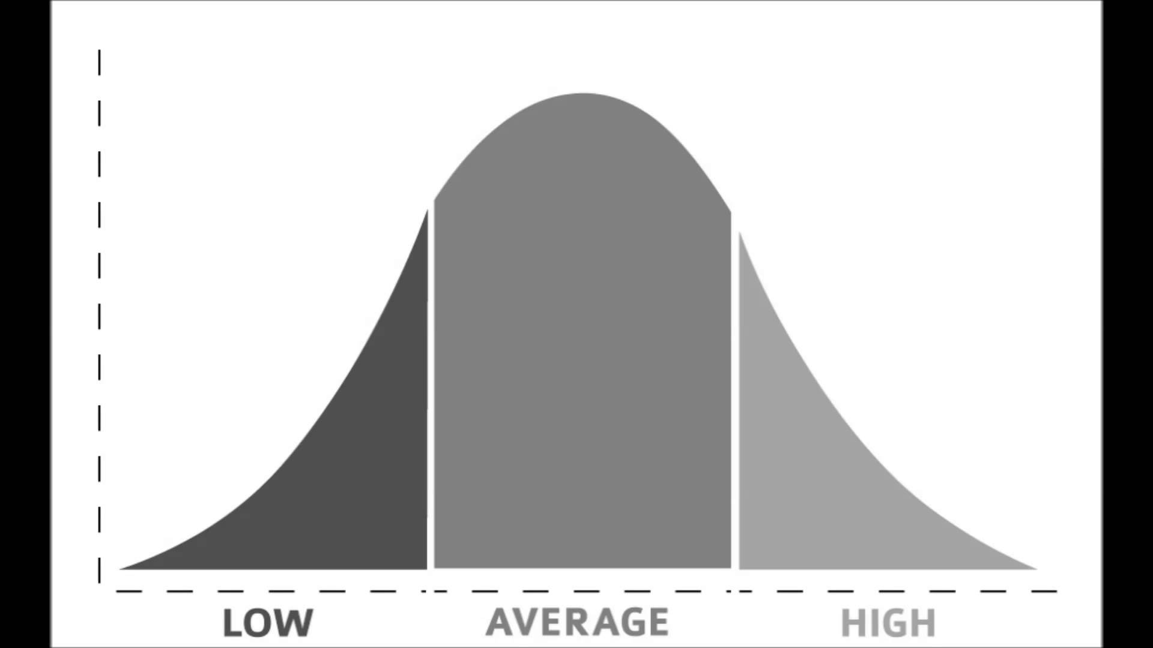
Data Normalization
The data was profiled using SQL Server Data Profiler
The profiler suggested that nine tables could be extracted from the large GT table.
Individual tables were created using the columns from GT. These nine individual tables were validated by joining back to GT.
The redundant columns were dropped form GT because they had been moved to the individual tables.
Primary keys were created on the nine tables.
From there, indices were created on the join columns in the GT table. Finally, a nine-way inner join was performed with the GT table to validate that everything has worked correctly.

Slide 12
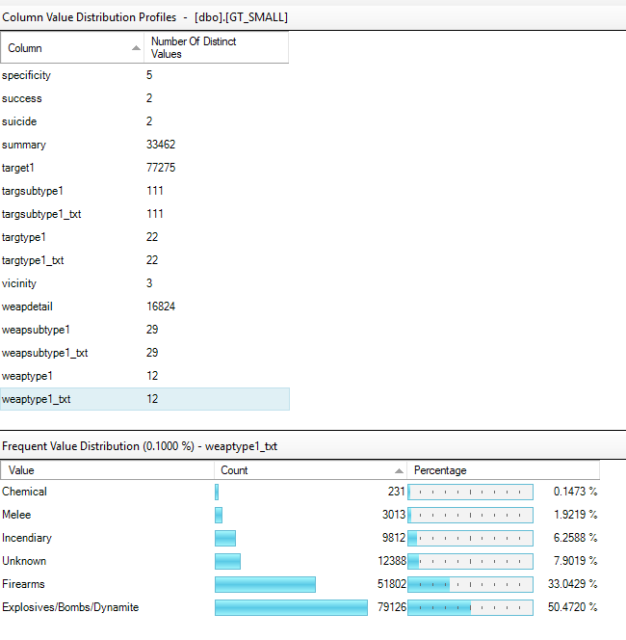
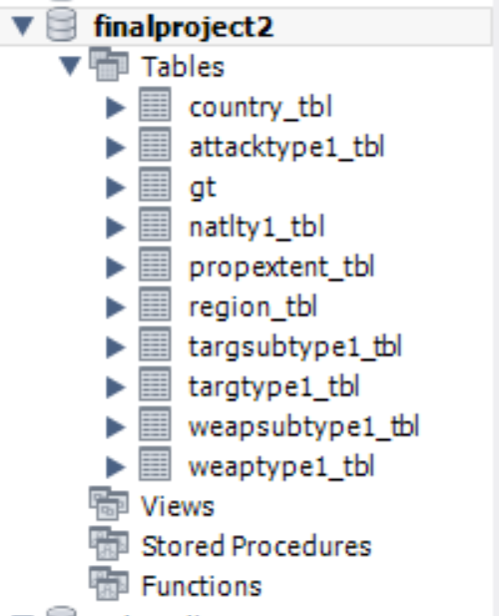
SQL Data Profiler
Normalized Data

Slide 13

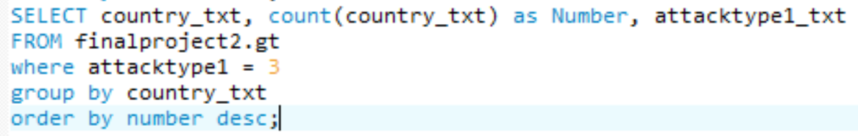
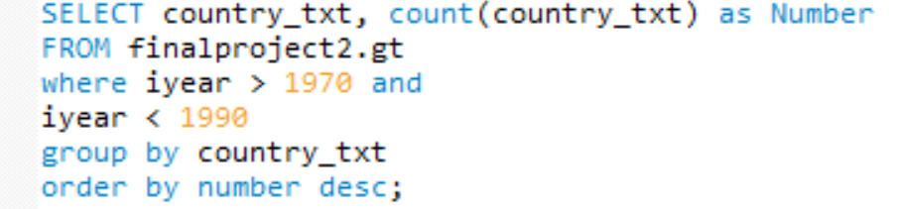
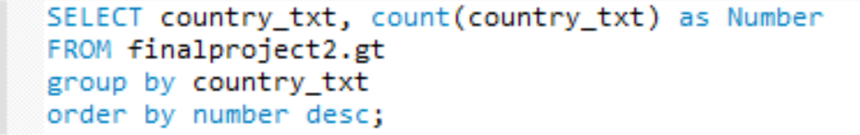
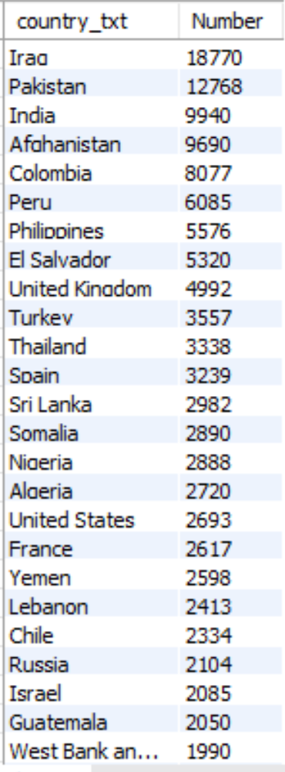
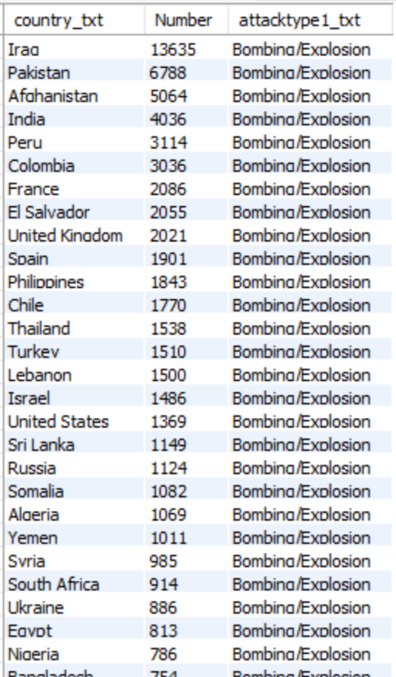
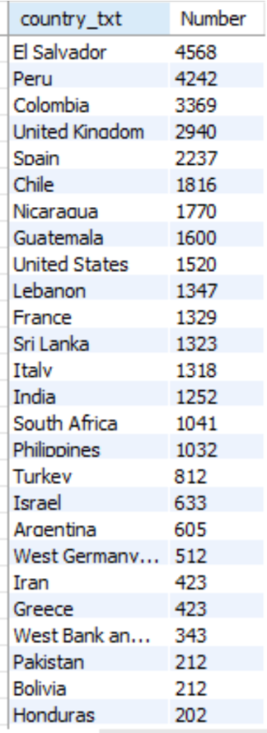
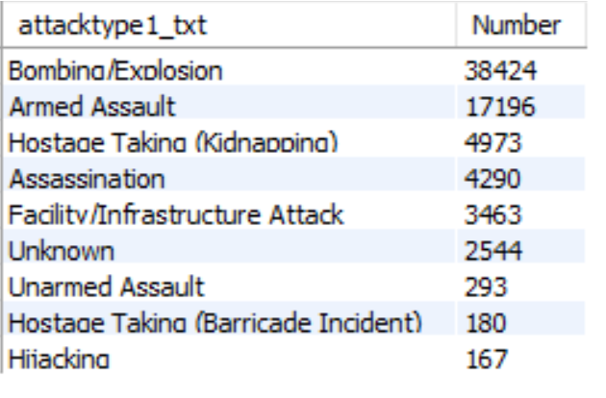
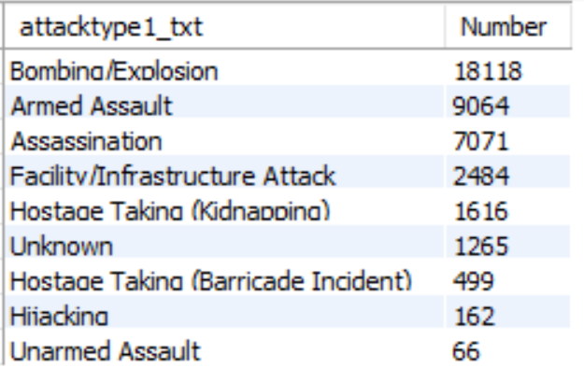
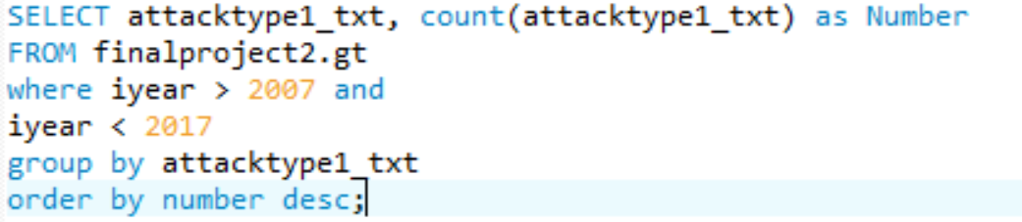
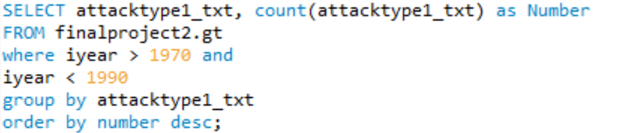
Data Analysis: SQL

Slide 14
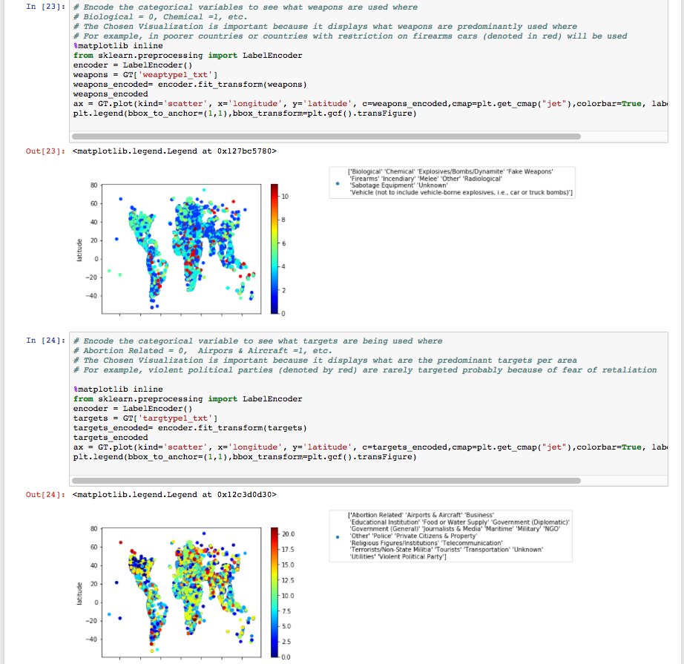

Data Analysis: Python
We used python to analyze the data, and found that weapon of choice in indigent countries is the motor vehicle.
Deduction: The favorite target of terrorists are abortion related centers and airports.

Slide 15
Weapon Usage
python analysis
Vehicle
Unknown
Sabotage
Radiological
Other
Melee
Incendiary
Firearms
Fake Weapons
Explosives/Bombs/Dynamite
Chemical
Biological
Encode categorical variables numerically
Identify which weapons are used more predominantly in each region
Developing regions : heavy use of motor vehicles as weapon of choice
Developed nations : wide range of weapons available
primary methods used rely on biological, chemical, explosive devices
Developing regions – weapons of opportunity
Developed nations – weapons of sophistication, planning, and significant impact

Slide 16
Targets
Violent Political Party
Utilities
Unknown
Transportation
Tourists
Terrorists/Non-state militia
Telecommunication
Religious figures / institutions
Private citizens & property
Police
Other
NGO
Military
Maritime
Journalists & media
Government
Diplomatic
Food / water supply
Educational institution
Business
Airports & aircraft
Abortion related
Identify the targets that are attacked more predominantly in each region
Violent political parties are rarely targeted
Airports and abortion centers are often targets of terrorist activity
Developing regions
targets highly varied : religious, private property, tourists, transportation
targets of opportunity and localized gain
Developed nations
targets of significant impact (aircraft) & specific political agendas (abortion)
targets of strategic advancement

Slide 17
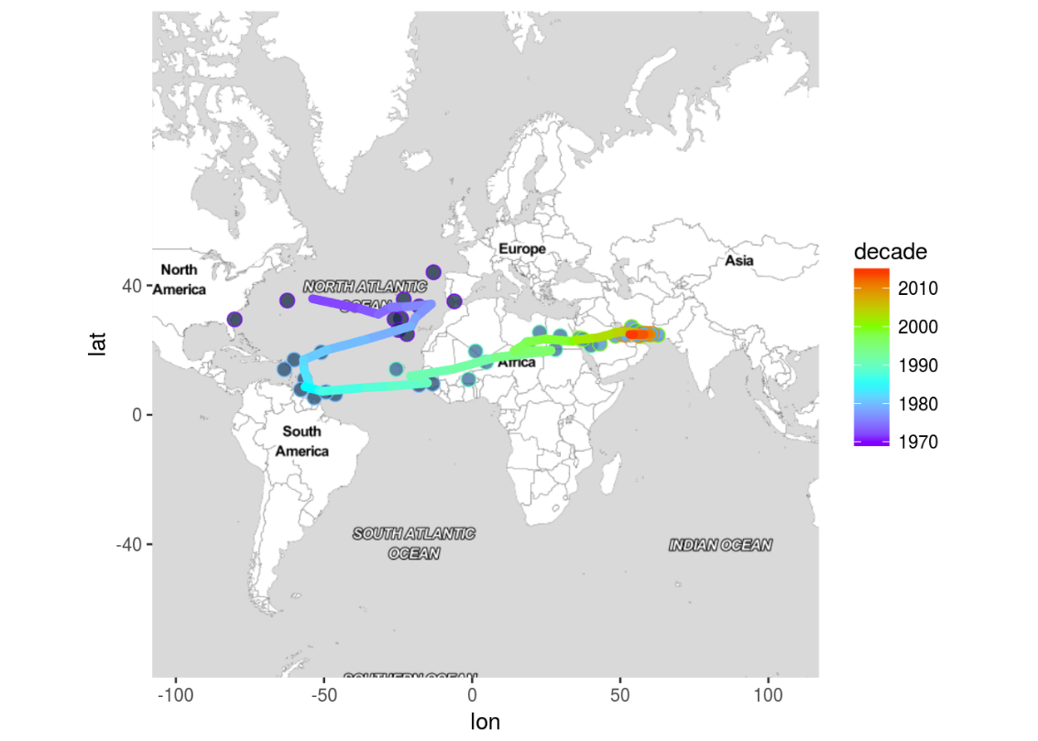
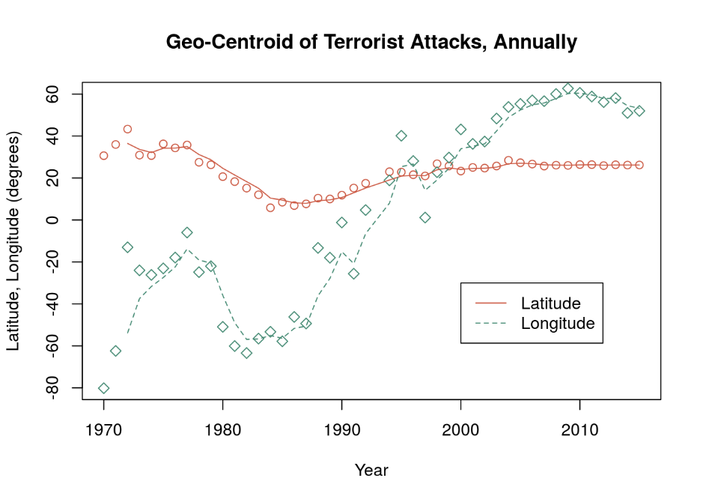

Data Analysis: R -Event Clustering and Geographic Trends
Doha, Qatar
Jacksonville, FL, USA
Geographic center of attacks for each year is depicted in longitude and latitude and also represented on earth map
1970 - center of terrorist events was just off coast of Florida, USA
each succeeding year and decade identifies migration of activity
1980s - towards western Europe, then west again to northern South America
1990s and after - steady migration east, to central Africa and currently in Mid-East
Terrorist activity – continually counter-responding to changing
geo-political pressures
Current locus of activity in Mid-East, southern Asia is also likely transitory
Notes:
For each year, the latitude / longitude points for each event were "averaged" to determine the ~center of activity for each year
These are shown as the lat /long points and in the figure on the left and also each point on the earth map represents one year's center of activity
The curve drawn thru the points is an exponentially-weighted curve, just to smooth out the curve and more easily identify the overall trend
The beginning of the experience is just off coast of Florida in 1970
terrorist activity in that era was in USA, Caribbean, and South America
The end of the curve is currently located near Doha, Qatar

Slide 18

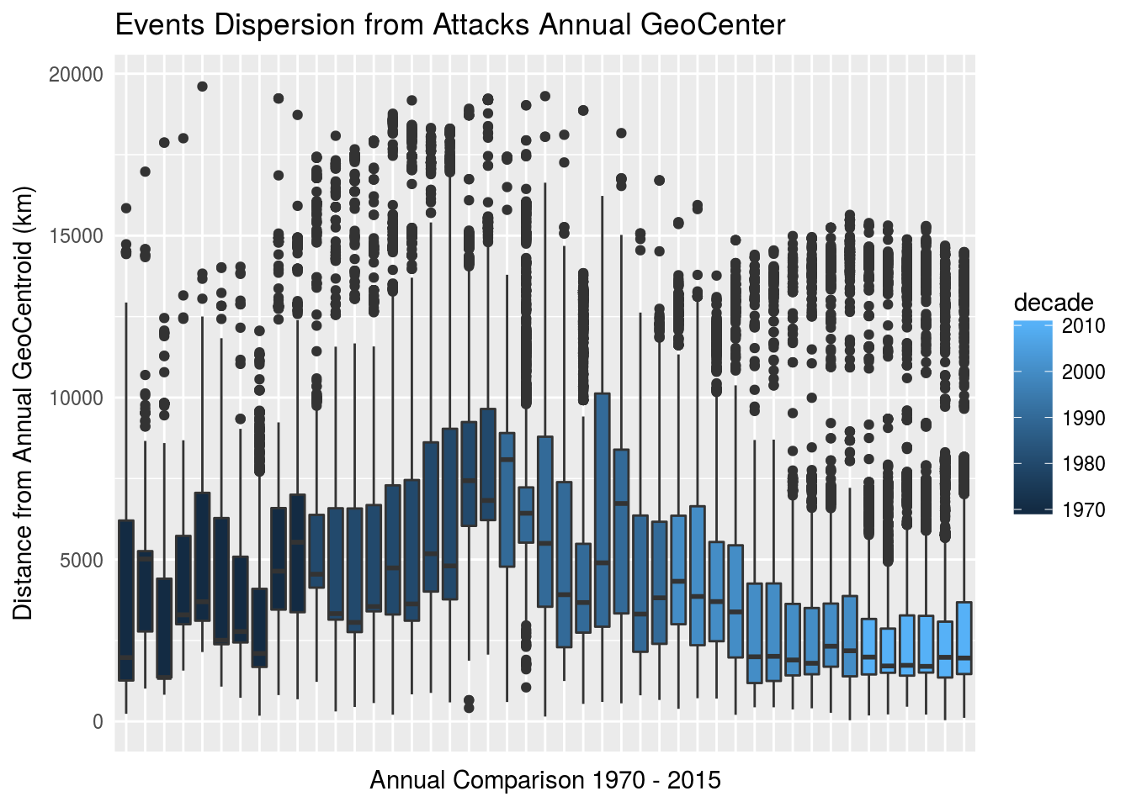
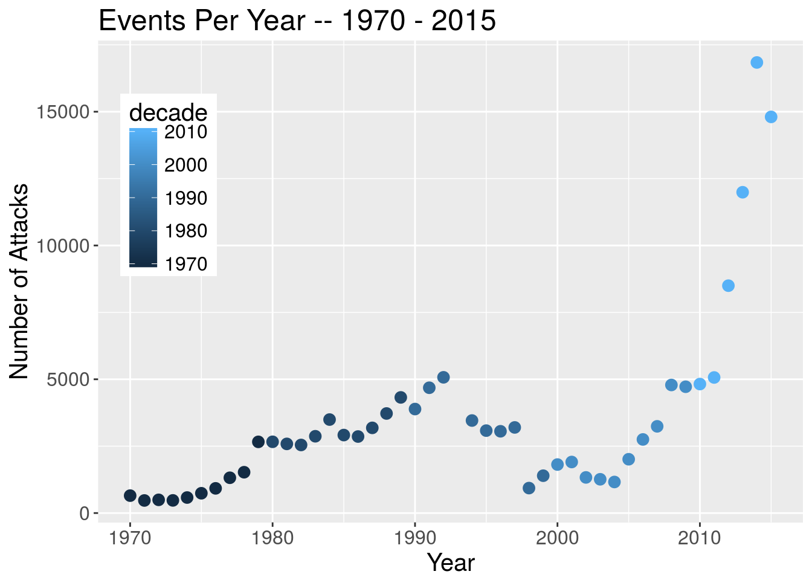
Geographic Center and Dispersion
Distributions of distances of attacks from the annual geo-centroid
1970s - unimodal distribution, within 5000 km of geo-centroid
1980s - centroid western Europe or northern South America
distance increases slightly
bi-modal trend begins to emerge - events consistently at 5000 km from annual center
1990s - centroid begins to march eastward across Africa
contraction in population distance from the annual meanr
return to a primarily unimodal distribution, as the overall
2000s - strong concentration to the annual center - within 4000 km of the annual center reappearance of a bi-modal distribution
2010s - least dispersion in the overall population difference from the annual centers.
Thus, in the current era, there is a very strong concentration of terrorist events in the Mid-East, and also two other locations affected by ~25% of the events, as shown by tri-modal distribution.
Events per Year
Notes:
The boxplots show the relative distance of all the events in each year from the center of that year's activity
E.g., the first boxplot shows that the distribution of events in 1970 is within ~5000 km of Jacksonville, FL
The last boxplot shows that ~75% of current terrorist activity is within ~2000 km of Qatar, with 2 smaller but identifiable clusters of events at ~7000 and 14000 km from Qatar
In addition, the bottom plot shows the events / year .. obviously significant increase in most recent years

Slide 19
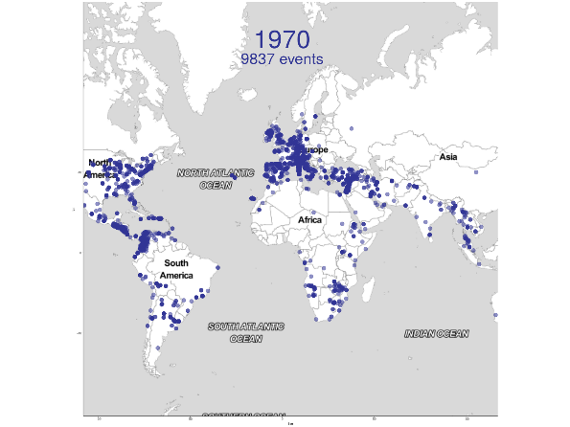
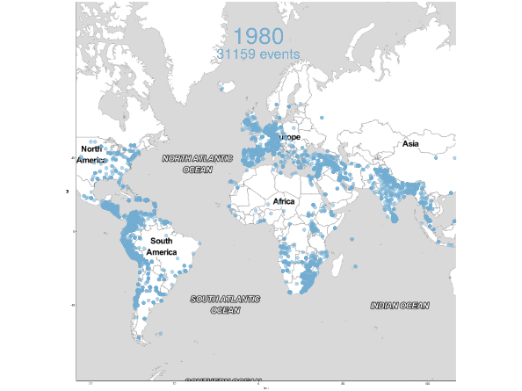
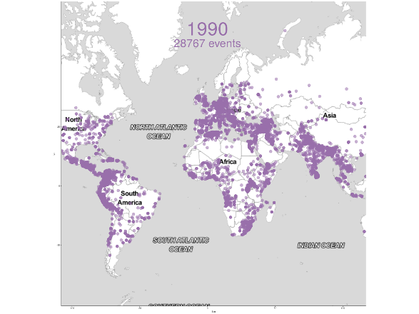
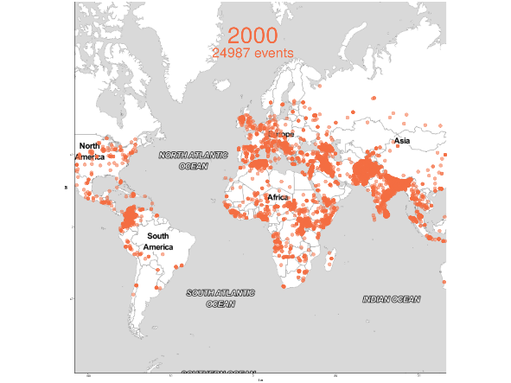
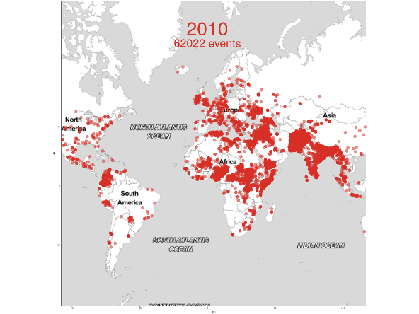
Lexicon of terrorism
Text mine : frequent and novel words, by decade
1970s | 1980s | 1990s | 2000s | 2010s
vietnam | ashley | gia (Algeria) | Kandahar, khost | asimah, huthis
selective | beseda | angola | basra, diyala, mosul | donetsk, luhansk
r.o.t.c | brockhoeft | india | ninawa | homs
draft | toledo | ireland | kirkuk | shebelle
colorado | contras | kosovo | khan | amanat, pakhtunkhwa
iowa | nicaragua | pakistan | aqlim | borno
manhattan | spinks | pastrana (Colombia) | pattani, yala | derna, sirte
ohio | sinhalese | samper (Colombia) | al qaida | hartal, ips, sabha
mexican | ltte |  | gaza | zuweid
puerto rico | csa | extremists | shi'a | haram, maiduguri
firebombed |  |  | somali | aqap
 |  |  |  | saladin
Viet Nam War USA sites Puerto Rican independence | Anti-abortion Anti-communism Munich Olympics Sri Lanka White supremacy | 5 continents terrorism is global 1st use of extremist as frequent description | Afghanistan Iraq Iran Kurdistan London Maghreb Thailand | Yemen, Ukraine Syria, Somalia Pakistan, Nigeria Libya, India Egypt, Boko Harum 12th century
Notes:
This chart shows changing language used in the events summary to describe / characterize the events in each decade
This was constructed from text mining the event summaries 150,000+ events.
For each decade, the middle table of the chart shows significant words from each decade …. from among the words that were NOT used in previous decades.
E.g., the words shown in the 1980s column are new words that were not used to describe events during the 1970s.
Similarly, the words shown in the 2010s columns are words which were not recorded in any of the prior decades' lexicon.
The bottom box is our interpretation of the themes of the terrorist activity, based on the results of the text mining of the database.
The top earth maps shows a point on the map for each event in that decade, also showing the changing geography that correspond to the changing vocabulary.
The last word in the 2010 box : Saladin refers to a 12th century Kurdish military leader …
"was the first sultan of Egypt and Syria … led the Muslim military campaign against the Crusader states in the Levant. At the height of his power, his sultanate included Egypt, Syria, Upper Mesopotamia, the Hejaz, Yemen and other parts of North Africa." – Wikipedia
He is referenced in the current era associated to the brutality of the methods by which he gained and retained power.

Slide 20

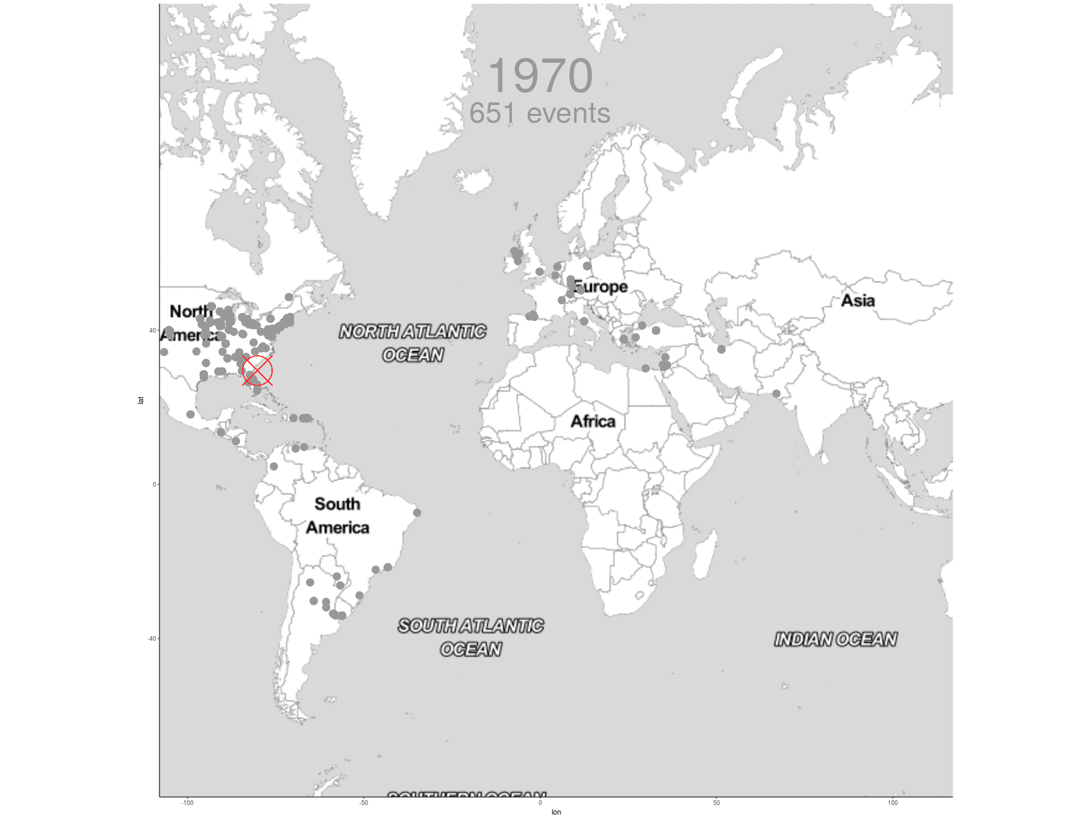
Analysis Insights
Developing vs. Developed Regions
Weapons comparison
opportune vs. sophisticated and larger impact
Targets comparison
opportune & localized gain vs. strategic
Geographic Trends
N. America → Europe → S. America – Africa – Mid-East / S. Asia
Dispersion and distribution – non-constant, currently heavily focused in S. Asia, with significant percentage of events in Africa and Mid-East
Exponential growth in last 5 years (3x)
Lexicon – Text Mining
Simple question : what words are new in event summary reporting ?
Provides opportunity for historical context
Ever evolving nature of global terrorism – causes, effects, locations

Slide 21

Summary
GTD – open source data
Raw data required significant manipulation
wrangled, organized, sql-ized, cleaned, normalized
Produced MySQL version of dataset for team exploitation
Analysis insights produced
Developing vs. Developed regions
Geographic trends
Lexical trends
Recent history of terrorism : non-constant
Exploring evolution of modern terrorism provides context of current events and prepares us for future developments

